Slide 1
CSE7302- University Project
Review-4
STUDENT INNOVATION:SWADESHI FOR ATMANIRBHAR BHARAT- SMART AUTOMATION
Batch Number:IST_27
Under the Supervision of,
Dr. Afroz Pasha, PhD, M.Tech., B.E.
Assistant Professor - Senior Scale
School of Computer Science and Engineering Presidency University
20221IST0055 | DARSHAN GOWDA S
20221IST0069 | CHETHAN C
20221IST0112 | CHIRAG GOWDA SV
Roll Number | Student Name
Name of the Program: Information Science And Technology
Name of the HoD: DR. PALLAVI R
Name of the Program Project Coordinator: MS. BENITHA CHRISTINAL J
Name of the School Project Coordinators: Dr. Sampath A K

Slide 2
Problem Statement Number: SIH25135
Organization: AICTE
Category (Hardware / Software / Both) :Software
Problem Description :
Industrial equipment failures lead to unplanned downtime; hence, productivity is duly reduced with increased operational costs.
Traditional approaches to maintenance are either reactive-after failure-or time-based and scheduled, mostly quite inefficient.
The objective of the project is to develop a Predictive Maintenance System with Machine Learning.
The system will analyze equipment operational data to find patterns that indicate early failure.
It will also predict equipment breakdowns prior to the actual occurrence.
The solution allows customers to proactively plan maintenance, thus reducing downtime, costs of maintenance, and operational risks.

Slide 3
Content:
Abstract
Problem Statement
Literature Survey
Objectives
Proposed SolutionFinal Layered System Architecture
Complete Module Implementation (Frontend & Backend)
Technology Stack & Deployment Environment
Project Status
GitHub Repository
Timeline
References

Slide 4
Abstract:
Aircraft turbofan engines require precise maintenance scheduling to prevent catastrophic failure and reduce operational costs.
This project proposes a Hybrid XGBoost–LSTM Ensemble for predicting the Remaining Useful Life (RUL) of turbofan engines .
Built on the NASA C-MAPSS benchmark dataset — 4 sub-configurations covering varying operating conditions and fault modes .
The LSTM captures sequential degradation patterns from sensor time-series; XGBoost learns from engineered statistical features .
A dataset-specific blending weight α optimally combines both model predictions.
Achieves RMSE of 15.58 on FD001 and 23.56 on FD004 — consistently outperforming both individual models
Deployed as a interactive Streamlit dashboard on Streamlit Cloud with real-time fleet monitoring and maintenance alerts

Slide 5
Problem Statement:
Aircraft engines degrade gradually over time — but operators have no reliable way to know exactly when an engine will need maintenance until it's too late or too early .
Fixing engines after failure is dangerous. Replacing parts on fixed schedules is wasteful. Neither approach is smart.
The real question is — can we look at what the engine's sensors are already telling us and predict exactly how much life it has left? .
The challenge is that engines don't all degrade the same way — different fault types, different operating conditions, and noisy sensor readings make this far harder than a simple trend line .

Slide 6
Literature Survey
Title | Existing Research (Authors) | Ref / Year | Methodology | Evaluation Metrics | Open Research Issues
AI-Powered Predictive Maintenance System for Industrial Equipment | Abdul Aziz, Sowmyashree P | 2025 | Hybrid AI PdM using sensor data, Autoencoder for anomaly detection, Gradient Boosting and LSTM for failure prediction, Hybrid health index generation | Precision, Recall, F1-score, Remaining Useful Life (RUL) MAE, downtime reduction, false alarm rate | Limited labelled failure data, heterogeneous sensor data integration, real-time deployment challenges, lack of explainable AI
A Review on Machinery Diagnostics and Prognostics Implementing Condition-Based Maintenance | Andrew K.S. Jardine, Daming Lin, Dragan Banjevic | 2006 | Condition-Based Maintenance framework involving data acquisition, signal processing, diagnostics and prognostics techniques | Reliability improvement, maintenance cost reduction, fault detection accuracy | Multi-sensor data fusion complexity, lack of standardized frameworks, real-time analytics limitations
Comparing Deep Learning and Fourier Series Models for Equipment Failure Prediction | Houria Abouloifa, Mohamed Bahaj | 2025 | Comparative predictive maintenance using Fourier series signal model and LSTM deep learning time-series prediction | MAE, MSE, RMSE, statistical significance testing, confidence interval validation | Lack of real industrial datasets, computational cost of DL models, integration difficulties

Slide 7
Literature Survey
Title | Existing Research (Authors) | Ref / Year | Methodology | Evaluation Metrics
Comparison of Deep Learning Models for Predictive Maintenance in Industrial Manufacturing Systems | Wenjun Li, Ting Li | 2025 | Deep learning PdM using CNN, LSTM and CNN-LSTM hybrid architectures for failure prediction and RUL estimation | Accuracy, F1-score, model robustness, generalization performance, feature importance analysis
Condition Monitoring and Predictive Maintenance in Industrial Equipment: NLP-Assisted Review | Jose Garcia, Luis Rios-Colque, Alvaro Peña, Luis Rojas | 2025 | NLP-based systematic literature review including ML, DL, signal processing methods (FFT, Wavelets, CEEMDAN) and hybrid physics-data models | Fault detection accuracy, RUL accuracy, deployment feasibility, energy efficiency improvement
IoT Based Predictive Maintenance in Industrial Machinery | Himmat Singh | 2025 | IoT PdM architecture using sensor networks, cloud analytics, ML-based failure prediction and real-time monitoring dashboard | Reliability improvement, maintenance cost reduction, breakdown reduction, equipment lifespan improvement

Slide 8
Literature Survey
Title | Existing Research (Authors) | Ref / Year | Methodology | Evaluation Metrics
Machine Learning-Based Predictive Maintenance of Industrial Machines | Chaitali Patil, Sanika Jadhav, Asmeeta Bardiya, Ankita Davande, Mahee Raverkar | 2023 | ML PdM system using Random Forest, SVM and Decision Tree, sensor monitoring, edge-cloud processing, alert generation | Prediction accuracy, feature selection performance, downtime reduction
Predictive Maintenance using Machine Learning in Industrial IoT | Jesu Narkarunai Arasu Malaiyappan, Gowrisankar Krishnamoorthy, Suhas Jangoan | 2024 | ML & DL techniques in IIoT including ANN models, deep learning prediction, real-time stream processing, cyber-physical system integration | Prediction latency, system reliability, real-time processing efficiency
A Review of Predictive Maintenance Methods for Electrical Machines Using ML Algorithms and Sensor Data | Nandni Sharma, Cheshtha Chauhan, Anju Dwivedi, Sanchita Dass | 2025 | ML-based PdM using Motor Current Signature Analysis, multi-sensor fusion, SVM, Random Forest, CNN, LSTM models | Accuracy, Precision, Recall, multi-modal sensor performance

Slide 9
Research Gap Identification
Existing studies validate CNN, LSTM, SVM, and Random Forest individually — but no work combines a sequential model with a statistical model and optimally blends them
Multi-condition datasets (6 operating regimes) are widely ignored — sensor baseline shifts are mistaken for degradation signals
LSTM models in literature treat all time steps equally — no attention mechanism to focus on the degradation phase
Research stops at the model — none of the surveyed papers connect predictions to a usable, real-time maintenance interface
No system monitors an entire fleet, ranks urgency, and prioritizes which engines need action today
Explainability is consistently flagged as future work — feature importance and sensor-level visualization are absent

Slide 10
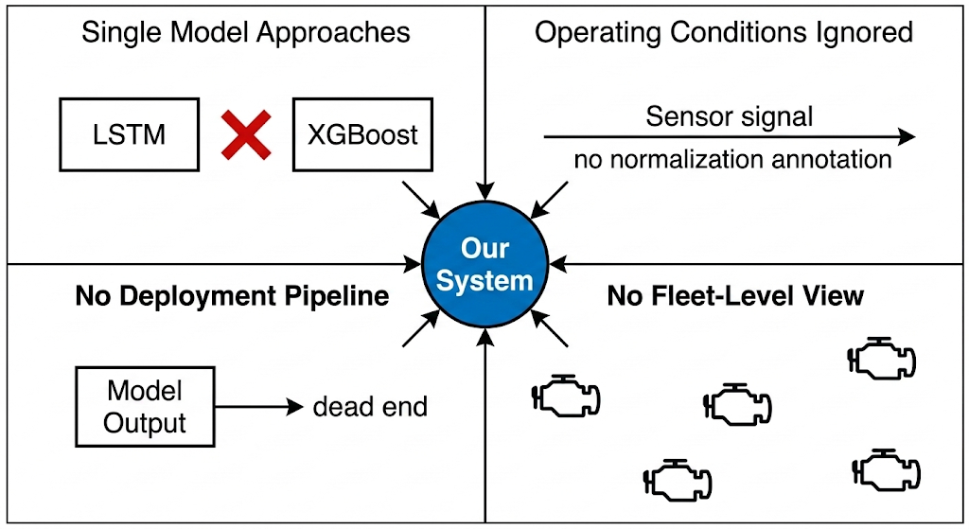
Research Gap Justification:

Slide 11
Research Gap Justification:
Every paper we reviewed solved a piece of the puzzle — but nobody put the whole picture together
Studies that used LSTM were great at reading time-series but blind to statistical patterns. Studies that used XGBoost were great at feature learning but couldn't track degradation over time.
Multi-condition engines were either avoided entirely or preprocessed in ways that destroyed the degradation signal. Nobody asked what happens when the same engine runs at 6 different altitudes
The models in literature make a prediction and stop. There's no next step — no "so what do I do with this number?" — no maintenance team in the loop
Most critically — none of the 9 papers we surveyed were tested on all 4 C-MAPSS sub-datasets together, meaning their results only hold under the easiest conditions

Slide 12
Objectives:
Build a model that doesn't just predict RUL — but predicts it accurately across all four dataset configurations, from the simplest single-condition setup to the hardest multi-condition, multi-fault scenario
Combine an LSTM with Attention (reads the sensor history like a timeline) and XGBoost (picks up statistical patterns the LSTM can't see) into one hybrid system that's stronger than either alone
Solve the multi-condition problem head-on — use KMeans clustering to identify operating regimes and normalize sensors within each one, so the model sees degradation, not flight conditions
Make the training robust — use Huber Loss so a few unusual engines don't derail the entire learning process
Don't stop at the model — connect every prediction to a live dashboard where a maintenance team can see which engines are critical, which are fine, and what to do next
Make the system explainable — show which sensors are driving the prediction and how they're trending over time

Slide 13
Proposed Solution:
Instead of picking one model and hoping it covers everything — we run two models in parallel and let them cover each other's blind spots
LSTM with Attention reads the engine's sensor history cycle by cycle, focusing on the moments where degradation actually starts showing up
XGBoost takes the same data, computes 112 statistical features across all 14 sensors, and finds patterns the LSTM can't see in raw sequences
Both make a prediction — then a learned blending weight α combines them into one final RUL estimate that's more accurate than either alone
Before any of this, the data goes through operating condition normalization so the models see true degradation — not just altitude changes
The output doesn't stop at a number — it feeds directly into a live dashboard that tells a maintenance team exactly which engines need attention and when

Slide 14
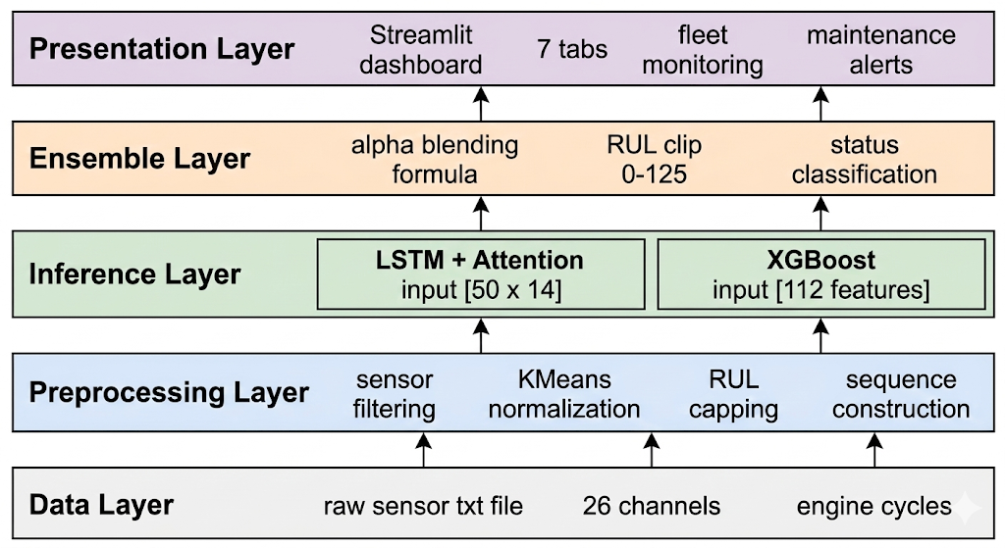
Final Layered System Architecture:

Slide 15
Final Layered System Architecture:
The system is designed as a five-layer pipeline where each layer has a single responsibility and passes its output upward to the next
Data Layer sits at the foundation — it accepts raw C-MAPSS test files containing 26 sensor and operational channels per engine cycle
Preprocessing Layer cleans and transforms the raw input — irrelevant sensors are dropped, operating conditions are normalized via KMeans clustering, RUL is capped at 125, and 50-cycle sequences are constructed
Inference Layer runs two models in parallel — the LSTM with Attention processes the temporal sequence while XGBoost processes the 112-dimensional statistical feature vector, each producing an independent RUL estimate
Ensemble Layer combines both outputs using the learned blending weight α, applies RUL clipping to [0, 125], and assigns a maintenance status — Critical, Warning, or Healthy
Presentation Layer delivers the final results through the Streamlit dashboard — engine gauges, fleet heatmaps, maintenance alerts, sensor degradation plots, and feature importance charts

Slide 16
Experimental Setup & Evaluation Metrics
Dataset: NASA C-MAPSS (FD001, FD002, FD003, FD004)
Hardware: Tesla T4 GPU (15.6 GB VRAM)
Data Split: 85% Train / 10% Validation / 5% Holdout (Engine-level, no leakage)
LSTM Epochs: 100 (FD001/FD003) | 120 (FD002/FD004)
Loss Function: Huber Loss (δ = 10) for outlier robustness
Random Seed: 42 (Full reproducibility)

Slide 17
Metrics Table
Metric | Formula | Interpretation
RMSE ↓ | √(Σ(ŷᵢ - yᵢ)² / N) | Sensitive to large errors. Safety-critical.
MAE ↓ | Σ|ŷᵢ - yᵢ| / N | Average prediction error in cycles.
R² ↑ | 1 - (SS_res / SS_tot) | Variance explained by the model.

Slide 18
Comparative Performance: LSTM vs. XGBoost vs. Hybrid Ensemble
Sub-dataset | Model Variant | RMSE ↓ | MAE ↓ | R² ↑
FD001 | LSTM with Attention | 15.58 | 11.29 | 0.8488
 | XGBoost | 22.80 | 14.17 | 0.6764
 | Hybrid Ensemble | 22.80 | 14.17 | 0.6764
FD002 | LSTM with Attention | 19.07 | 12.12 | 0.8028
 | XGBoost | 20.94 | 14.68 | 0.7621
 | Hybrid Ensemble | 17.47 | 11.68 | 0.8345
FD003 | LSTM with Attention | 13.54 | 9.24 | 0.8804
 | XGBoost | 16.90 | 10.84 | 0.8138
 | Hybrid Ensemble | 16.90 | 10.84 | 0.8138
FD004 | LSTM with Attention | 23.81 | 13.95 | 0.6932
 | XGBoost | 26.72 | 17.35 | 0.6134
 | Hybrid Ensemble | 23.56 | 13.81 | 0.6996

Slide 19
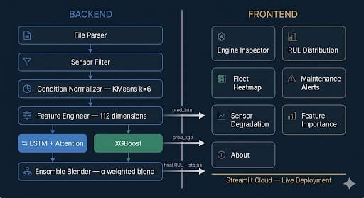
Complete Module Implementation (Frontend & Backend):

Slide 20
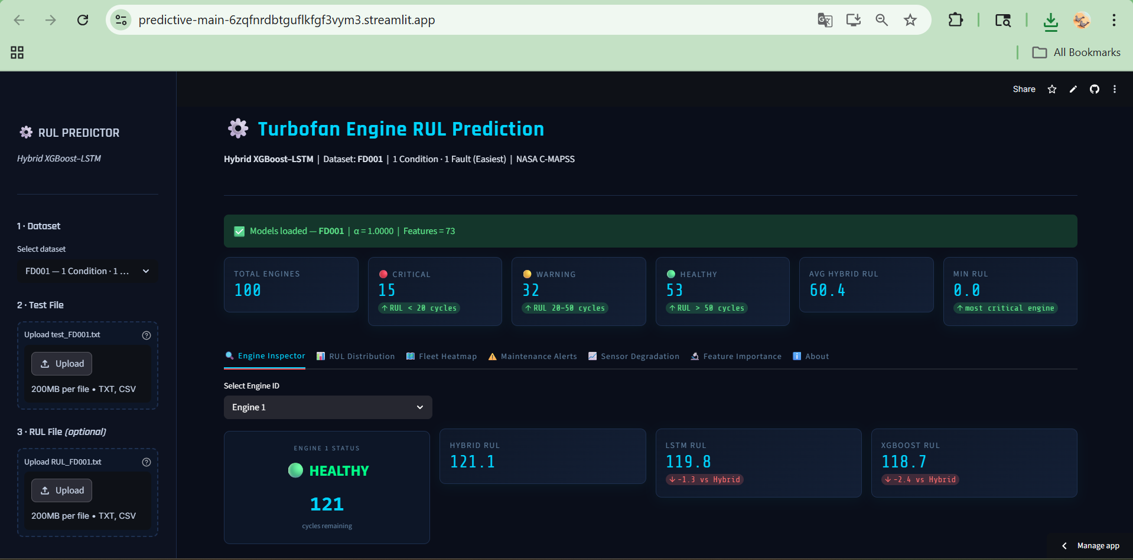
Streamlit Deployment

Slide 21
Complete Module Implementation (Frontend & Backend):
Backend:
The raw sensor file is parsed, seven non-informative channels are dropped, and only the 14 sensors carrying actual degradation signal are retained.
For multi-condition datasets, KMeans clustering identifies which operating regime each engine is running in and normalizes sensors within that regime so the model sees wear, not altitude changes.
Eight statistical features are computed per sensor, producing a 112-dimensional vector for XGBoost while the same data is shaped into a 50-cycle sequence for the LSTM with Attention.
Both models produce independent RUL estimates which are blended using a pre-optimized weight α and clipped to a valid range of 0 to 125 cycles.

Slide 22
Complete Module Implementation (Frontend & Backend):
Frontend:
Once a test file is uploaded, seven dashboard tabs activate — each answering a different question about engine health.
The Engine Inspector shows where one engine stands, the Fleet Heatmap shows where the entire fleet stands, and Maintenance Alerts tells you who needs attention first.
Sensor Degradation shows why an engine is flagged, and Feature Importance shows what the model is reacting to.
Everything runs in real time, with all model artifacts cached at startup and the full system deployed live on Streamlit Cloud.

Slide 23
Technology Stack & Deployment Environment
Frontend Layer:
Streamlit (7-tab interactive dashboard framework)
Plotly & Plotly Express for all interactive charts and visualizations
Custom CSS for dark theme styling and responsive layout
Backend Layer:
Python 3.9+ as the core runtime environment
Pandas & NumPy for data parsing, feature engineering, and sequence construction
Scikit-learn for MinMaxScaler normalization and KMeans clustering
AI & Machine Learning:
PyTorch 2.x for LSTM with Attention model training and inference
XGBoost 1.7 for gradient-boosted statistical feature learning
Hybrid Ensemble with dataset-specific learned blending weight α
Model Persistence:
PyTorch state dict (.pt) for LSTM weight storage
XGBoost JSON format for booster model storage
Joblib (.pkl) for scaler and NumPy (.npy) for feature metadata
Deployment Environment:
Deployed on Streamlit Community Cloud via GitHub integration
All 20 model artifacts pre-loaded and cached at startup using @st.cache_resource
Zero local installation required — fully browser accessible.

Slide 24
Project Status:
Model Development:
LSTM with Attention model fully trained and validated across all 4 C-MAPSS sub-datasets
XGBoost regressor trained with optimized hyperparameters and early stopping
Hybrid ensemble blending weights (α) learned and saved per dataset
Preprocessing Pipeline:
Sensor filtering, KMeans normalization, feature engineering, and sequence construction fully implemented and tested
All 20 model artifacts (LSTM, XGBoost, Scaler, Features, Alpha) saved and version controlled
Dashboard:
All 7 tabs fully functional — Engine Inspector, RUL Distribution, Fleet Heatmap, Maintenance Alerts, Sensor Degradation, Feature Importance, About
Real-time inference on uploaded test files working end-to-end
Deployment:
Live on Streamlit Community Cloud via GitHub integration
Accessible via browser with no local installation required

Slide 25
Github and Streamlit Links:
The Github link provided should have public access permission.
GitHub Repository Link:
https://github.com/darshan99009/IST_27-Capstone_Project/
Streamlit deployment link:
https://predictive-main-6zqfnrdbtguflkfgf3vym3.streamlit.app/

Slide 26
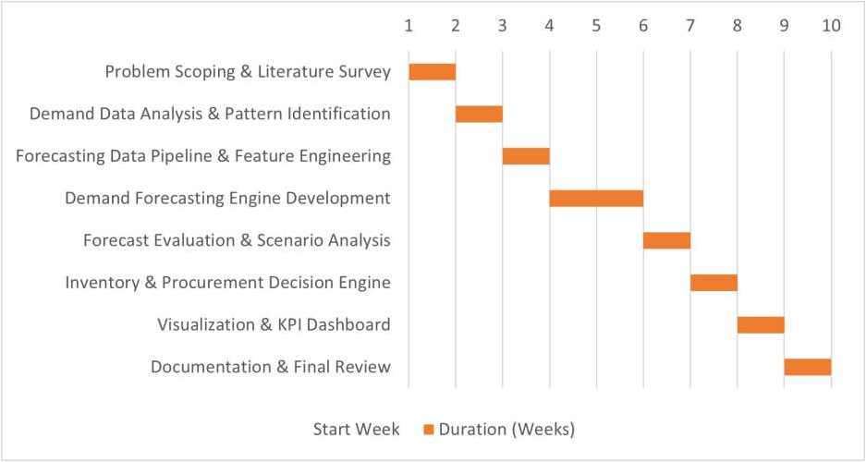
Timeline:

Slide 27
References ( IEEE Paper Format ):
[1] AI-Powered Predictive Maintenance System for Industrial Equipment: Reducing Downtime and Costs Through Sensor-Based Analytics, 2025.
[2] A. K. S. Jardine, D. Lin, and D. Banjevic, “A Review on Machinery Diagnostics and Prognostics Implementing Condition-Based Maintenance,” Mechanical Systems and Signal Processing, 2006.
[3] H. Abouloifa and M. Bahaj, “Comparing Deep Learning and Fourier Series Models for Equipment Failure Prediction in Predictive Industrial Maintenance 4.0,” Scientific Reports, 2025.
[4] W. Li and T. Li, “Comparison of Deep Learning Models for Predictive Maintenance in Industrial Manufacturing Systems Using Sensor Data,” Scientific Reports, 2025.

Slide 28
References ( IEEE Paper Format ):
[5] J. Garcia, L. Rios-Colque, A. Peña, and L. Rojas, “Condition Monitoring and Predictive Maintenance in Industrial Equipment: An NLP-Assisted Review of Signal Processing, Hybrid Models, and Implementation Challenges,”
[6] H. Singh, “IoT-Based Predictive Maintenance in Industrial Machinery,” International Journal for Modern Trends in Science and Technology, 2025.
[7] C. R. Patil, S. K. Jadhav, A. L. Bardiya, A. P. Davande, and M. P. Raverkar, “Machine Learning-Based Predictive Maintenance of Industrial Machines,” International Journal of Computer Trends and Technology, 2023.
[8] J. N. A. Malaiyappan, G. Krishnamoorthy, and S. Jangoan, “Predictive Maintenance Using Machine Learning in Industrial IoT,” International Journal of Innovative Science and Research Technology, 2024.

Slide 29
References ( IEEE Paper Format ):
[9] A Review of Predictive Maintenance Methods for Electrical Machines Using Machine Learning Algorithms and Sensor Data, 2025.

Slide 30


